Slide 1
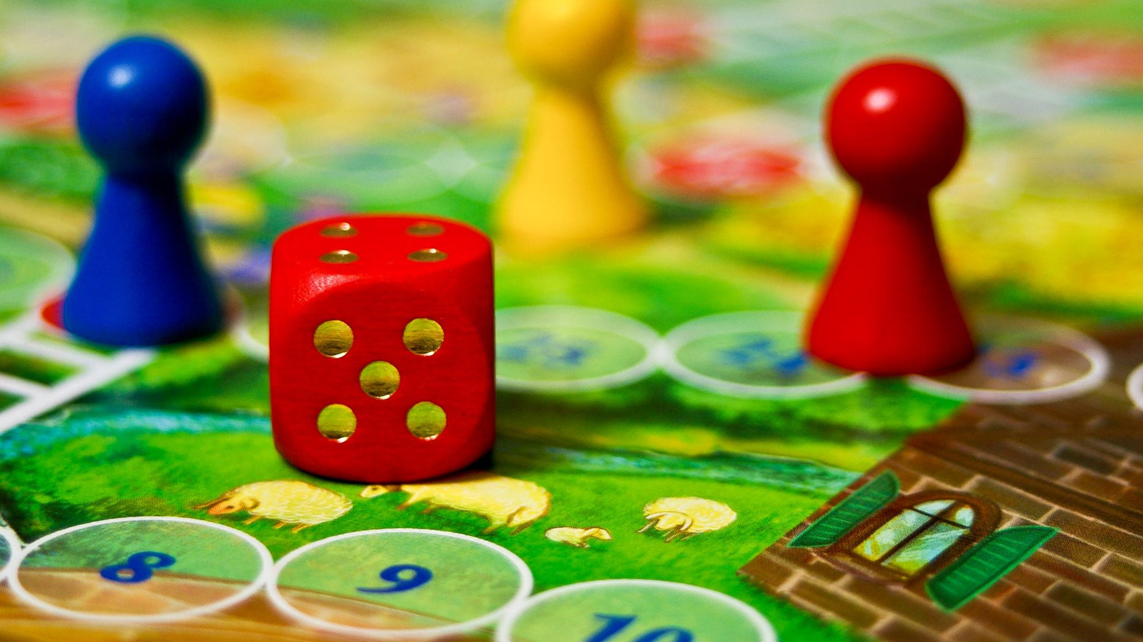
Board Game Set with Three Exciting Games
Elle O’Donnell-Craig, Nathan Scales,
Junyi Chen, Haotian Wu, Bo Yuan, Zichen Zhao

Slide 2
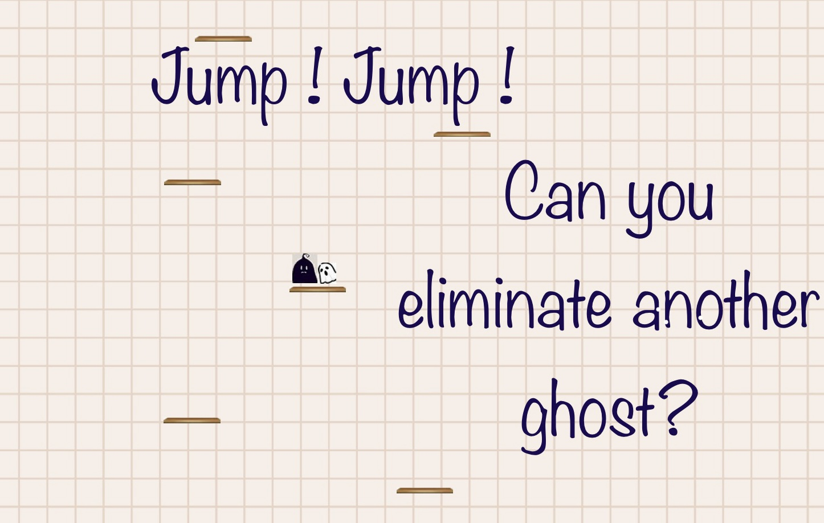
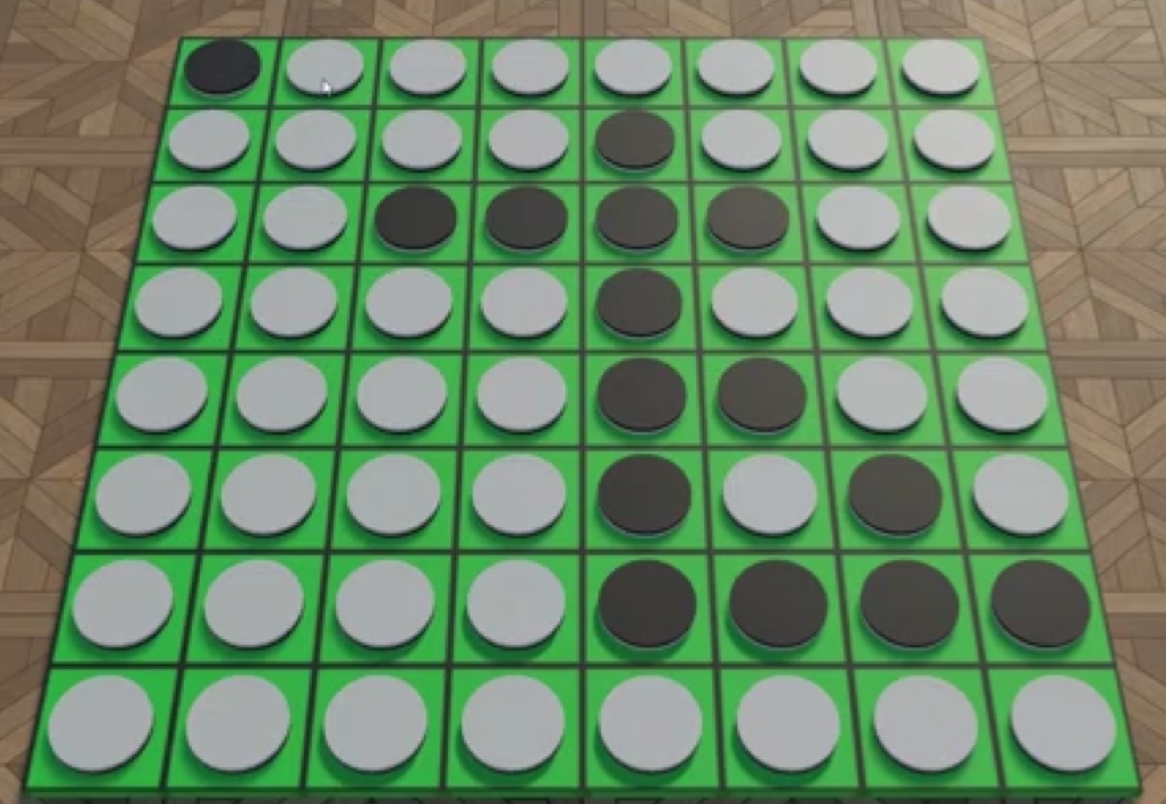
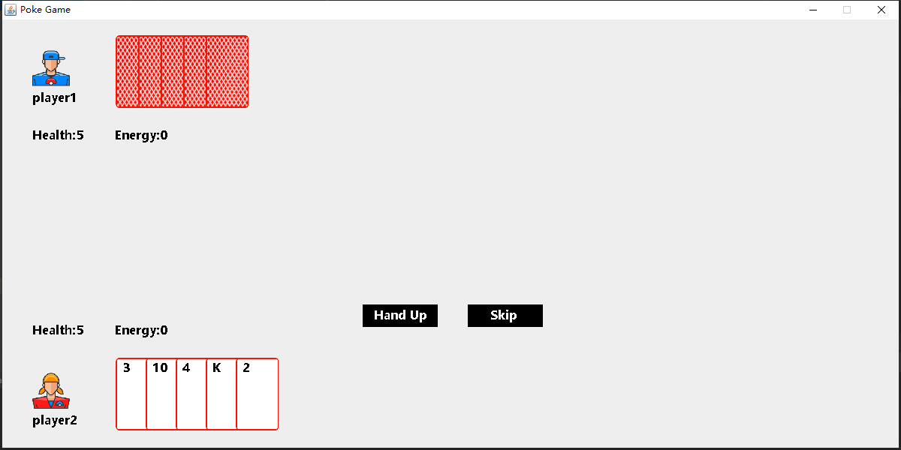
Introduction
Othello
PRESSURE
Jump! Jump!

Slide 3
Download and install
https://github.com/cjyaws/board-game-set.git

Slide 4
Download and install
https://github.com/cjyaws/board-game-set.git

Slide 5
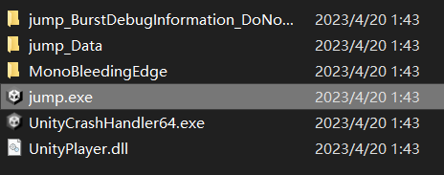
Download and install
https://github.com/cjyaws/board-game-set.git

Slide 6
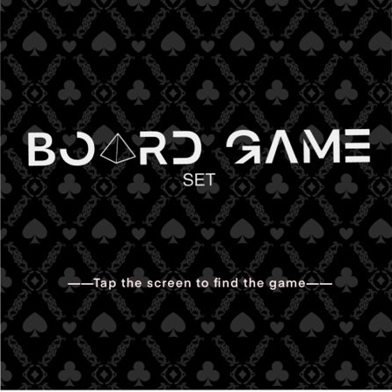
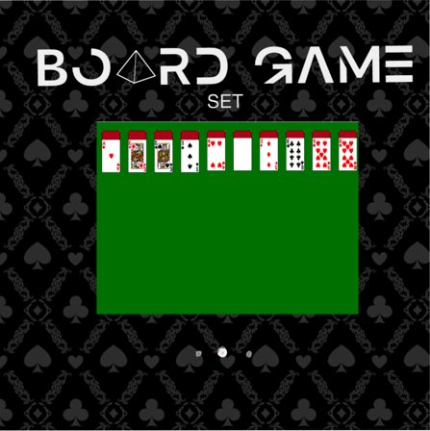

Slide 7
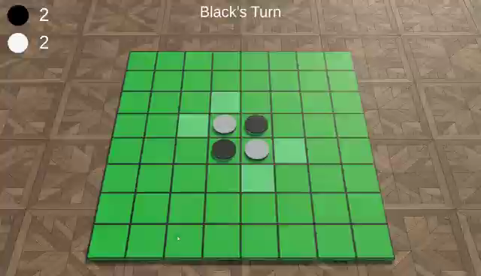
Othello
Othello is a board game for two players on an 8x8 board, one playing as black and the other white.
Players take turns placing discs of their colour on the board, they can only place a disc where it will form a line where any number of the opponent’s discs are enclosed between their own. Then each of the enclosed discs is flipped over to the other colour.
The game ends when there are no possible moves, where the winner is the player with the most discs of their colour facing up.
This computer version of the game is played by two players on the same device; However, we plan on adding a feature for a player to play against the computer.

Slide 8

Jump! Jump!
One night a student didn't put away his scratch paper after finishing his homework. Suddenly two ghosts and many platforms appeared on the paper, and they found themselves with a powerful jumping ability on this paper. The two ghosts jumped up together hoping to find the end of these platforms and escape from this scratch paper. During the long journey, they found that the platforms were endless, and the only way to escape from the paper was to drive another ghost out of the picture, so they began to fight.

Slide 9
PRESSURE
"PRESSURE" is a unique poker game that combines traditional card game mechanics with new rules and elements. In this game, players use a deck of basic poker cards along with special draw and discard cards and three status values: health (represented by hearts), damage (represented by spades), and energy (represented by clubs). There is also a core element called "pressure

Slide 10
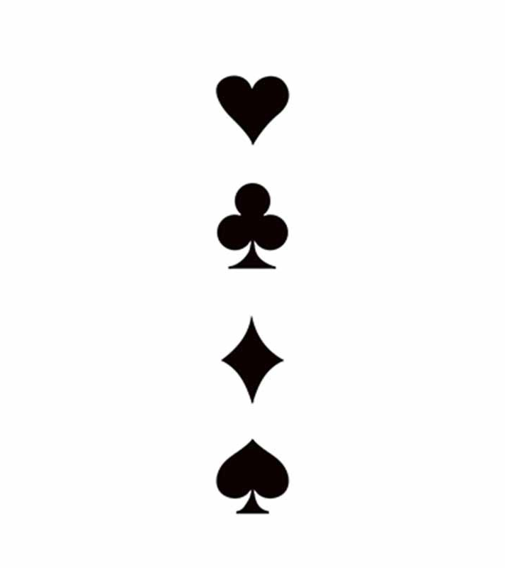
PRESSURE
The four suits in the game are spades, hearts, diamonds, and clubs. The face cards J, Q, and K are counted as 11, 12, and 13, respectively.
Spades are attack cards that cause damage to the opponent, deducting from their health value.
Hearts are health cards that can either create maximum health based on its card points or restore lost health by doubling its card points.
Diamonds are substitution cards that can be used in place of any of the other three suits of the same number of points.
Clubs represent energy, which is used to play cards. Each card played consumes energy, and the energy consumption increases with each additional card played.

Slide 11
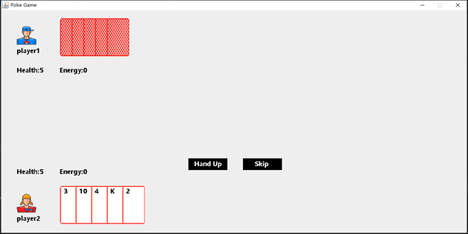
PRESSURE
At the start of each turn, players draw two cards from the deck.
The player's initial hand count is five, and their health is also set to five.
If a player's health falls to zero or below and there is no hearts card to restore it, the player loses the game.

Slide 12
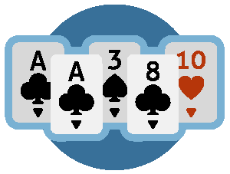
PRESSURE
The game has a "pressure" mechanism that affects gameplay based on the number of cards in a player's hand. For every five cards in hand, a layer of pressure is added.
When a player reaches high pressure, which is when they have more than 20 cards in hand, their energy consumption increases, and they must bear half the damage from the sum of all types of cards they played in that stage.
When a player is under low pressure, which is when they have less than five cards in hand, they have a chance of only being able to draw one card during the draw stage.
When a player's card count is between 11-15, they draw three cards per turn, and when it's between 16-20, they draw four cards per turn.

Slide 13
THANKS FOR WATCHING

